Slide 1

Indicator Availability for RC Countries
Global SDG Indicator Database
8 March 2019

Slide 2
Data availability by goal

Slide 3
Latest year available for poverty Indicators:
2017

Slide 4
Latest year available for poverty Indicators:
2017

Slide 5

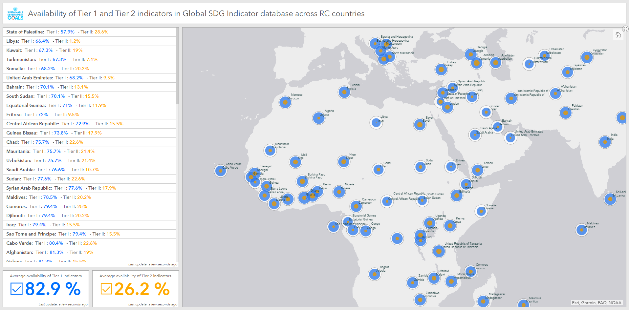
Indicator Availability Dashboard
http://arcg.is/1jq0n9

